Slide 1
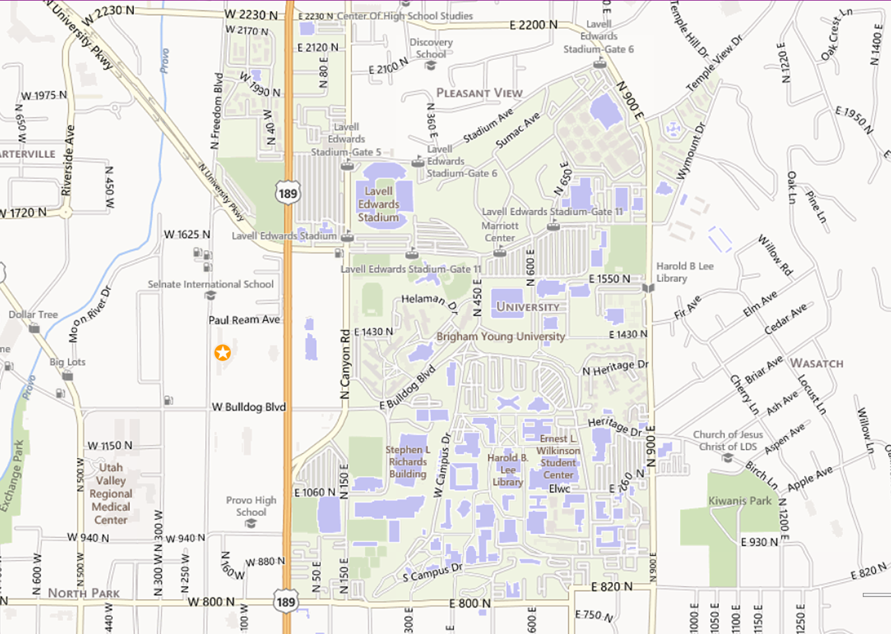
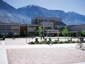
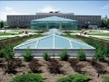
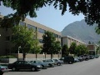
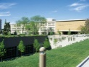
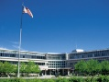
Buildings
Favorites
Wilkinson Student Center
WILK
Harold B. Lee Library
HBLL
My Classes
Talmage Math Sciences Building
TMCB
Jesse Knight Building
JKB
Thomas L. Martin Building
MARB
All
Abraham O. Smoot Admininstrati…
ASB
Allen Hall (Museum of Peoples …
ALLN
Auxiliary Services Maintenance
AXMB
B-34, B-38, B-41, B-51
B34
B-66 Classrom/Lab Building
B66

Slide 2


BYU MAPS
Connected to
Buildings
BUILDINGS
COMPUTER LABS
DINING
SERVICES
Favorites
PARKING
PRINTING
ENTERTAINMENT
SPORTS
Wilkinson Student Center
WILK
Harold B. Lee Library
HBLL
My Classes
Talmage Math Sciences Building
TMCB
Jesse Knight Building
JKB
Thomas L. Martin Building
MARB
All
Abraham O. Smoot Admininstrati…
ASB
Allen Hall (Museum of Peoples …
ALLN
Auxiliary Services Maintenance
AXMB
B-34, B-38, B-41, B-51
B34
B-66 Classrom/Lab Building
B66

Slide 3
Buildings
Favorites
Wilkinson Student Center
WILK
Harold B. Lee Library
HBLL
My Classes
Talmage Math Sciences Building
TMCB
Jesse Knight Building
JKB
Thomas L. Martin Building
MARB
All
Abraham O. Smoot Admininstrati…
ASB
Allen Hall (Museum of Peoples …
ALLN
Auxiliary Services Maintenance
AXMB
B-34, B-38, B-41, B-51
B34
B-66 Classrom/Lab Building
B66

